Slide 1
Homomorphic Encryption for Arithmetic of Approximate Numbers
Notes:
이 스킴은 m1+m2와 m1m2 연산을 미리 정해진 자릿수 까지 근사값을 구할 수 있다는 것.
링 LWE 문제로부터 생겨나는 오차를 근사 연산 오차로 취급?
몇몇 LSB들을 제거하고 숫자의 크기와 정확도 감소를 트레이드 오프로.

Slide 2
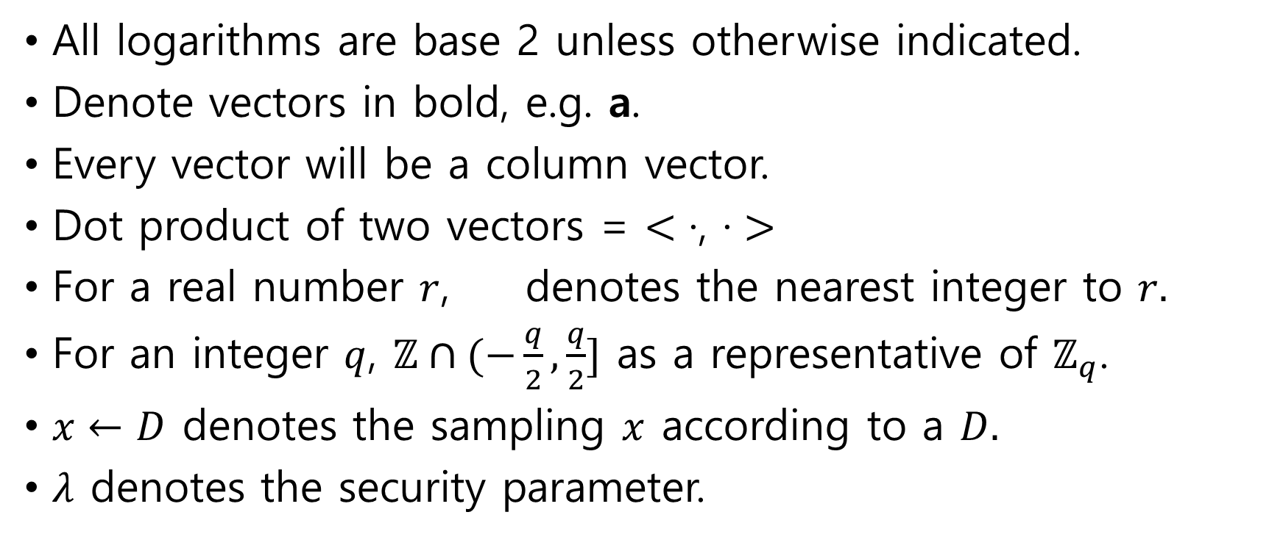
Basic Notation
All logarithms are base 2 unless otherwise indicated.
Denote vectors in bold, e.g. a.
Every vector will be a column vector.
Dot product of two vectors = $<\text{·,} \text{·}>$
For a real number $r$, denotes the nearest integer to $r.$
For an integer $q$, $ℤ∩(−\frac{q}{2},\frac{q}{2}]$ as a representative of $ℤ_{q}$.
$x←D$ denotes the sampling $x$ according to a $D.$
$λ$ denotes the security parameter.

Slide 3
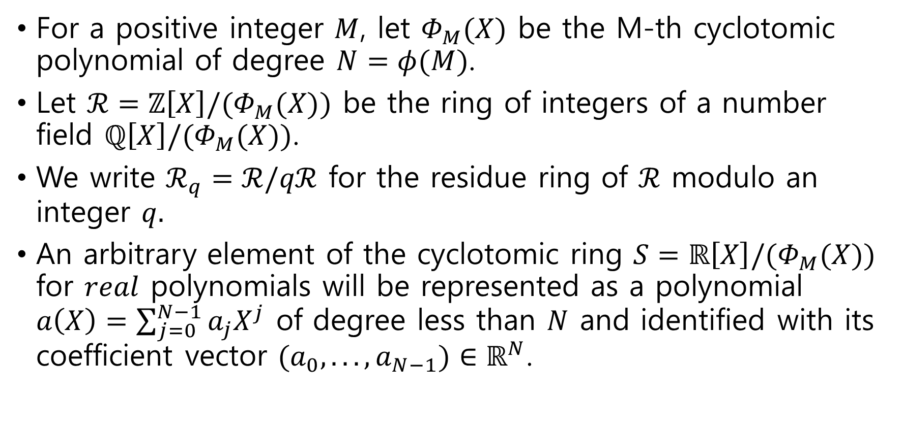
The Cyclotomic Ring and Canonical Embedding
For a positive integer $M$, let $Φ_{M}(X)$ be the M-th cyclotomic polynomial of degree $N=φ(M)$.
Let $ℛ=ℤ\left[X\right]/(Φ_{M}(X))$ be the ring of integers of a number field $ℚ\left[X\right]/{(Φ}_{M}(X))$.
We write $ℛ_{q}=ℛ/qℛ$ for the residue ring of $ℛ$ modulo an integer $q.$
An arbitrary element of the cyclotomic ring $S=ℝ\left[X\right]/(Φ_{M}(X))$ for $real$ polynomials will be represented as a polynomial $a\left(X\right)=\sum_{j=0}^{N−1}{a_{j}X^{j}}$ of degree less than $N$ and identified with its coefficient vector $(a_{0}, . . .,a_{N−1})∈ℝ^{N}$.

Slide 4
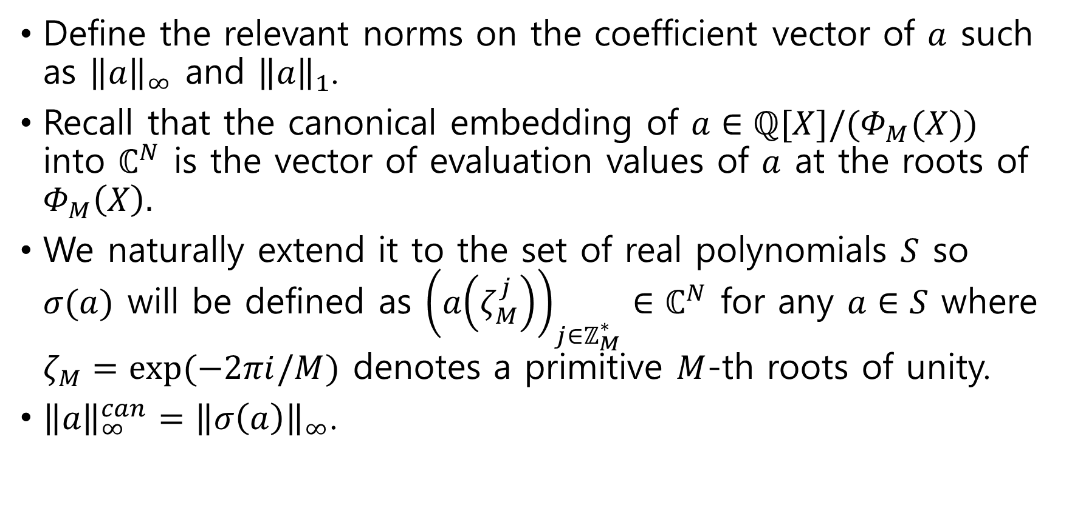
The Cyclotomic Ring and Canonical Embedding
Define the relevant norms on the coefficient vector of $a$ such as ${\left\|a\right\|}_{∞}$ and ${\left\|a\right\|}_{1}$.
Recall that the canonical embedding of $a∈ℚ[X]/(Φ_{M}(X))$ into $ℂ^{N}$ is the vector of evaluation values of $a$ at the roots of $Φ_{M}\left(X\right).$
We naturally extend it to the set of real polynomials $S$ so $σ(a)$ will be defined as ${\left(a\left(ζ_{M}^{j}\right)\right)}_{j∈ℤ_{M}^{∗}}∈ℂ^{N}$ for any $a∈S$ where $ζ_{M}=exp⁡(−2πi/M)$ denotes a primitive $M$-th roots of unity.
${\left\|a\right\|}_{∞}^{can}={\left\|σ\left(a\right)\right\|}_{∞}$.

Slide 5
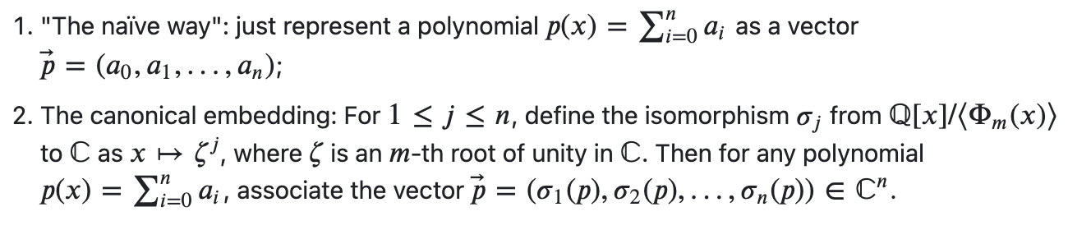

The Cyclotomic Ring and Canonical Embedding
The ring constant is obtained by $c_{M}={\left\|CRT_{M}^{−1}\right\|}_{∞}$ where $CRT_{M}$ is the CRT matrix for $M$.
The norm for a matrix $U={\left(u_{ij}\right)}_{0≤i,j<N}$ is defined by ${\left\|U\right\|}_{∞}=\max_{0≤i<N}{\{\sum_{j=0}^{N−1}{|u_{ij}|}\}}.$

Slide 6
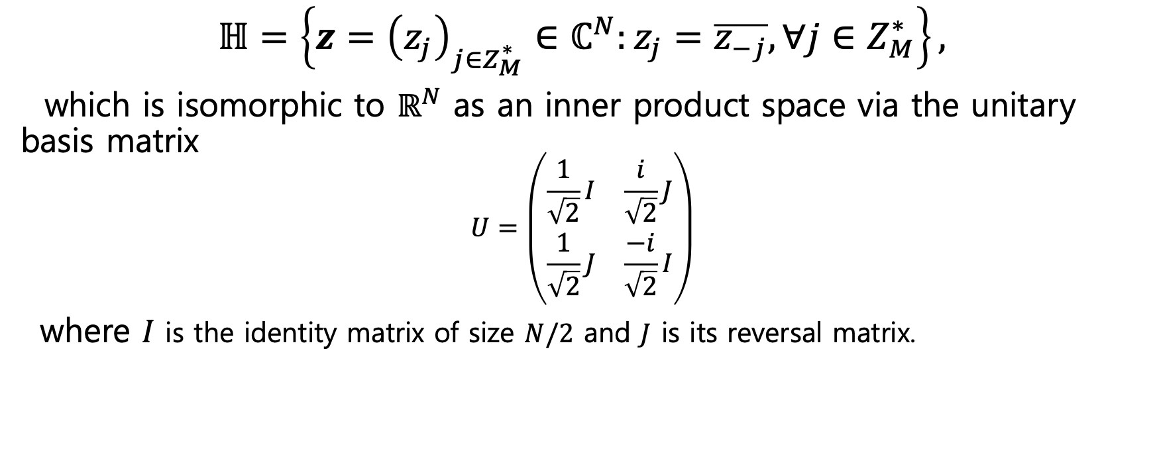
Gaussian Distributions and RLWE Problem
$$ℍ=\left\{z={\left(z_{j}\right)}_{j∈Z_{M}^{∗}}∈ℂ^{N}:z_{j}=\overline{z_{−j}},∀j∈Z_{M}^{∗}\right\},$$
which is isomorphic to $ℝ^{N}$ as an inner product space via the unitary basis matrix
$$U=\left(\begin{matrix}\frac{1}{\sqrt{2}}I & \frac{i}{\sqrt{2}}J \\ \frac{1}{\sqrt{2}}J & \frac{−i}{\sqrt{2}}I\end{matrix}\right)$$
where $I$ is the identity matrix of size $N/2$ and $J$ is its reversal matrix.

Slide 7
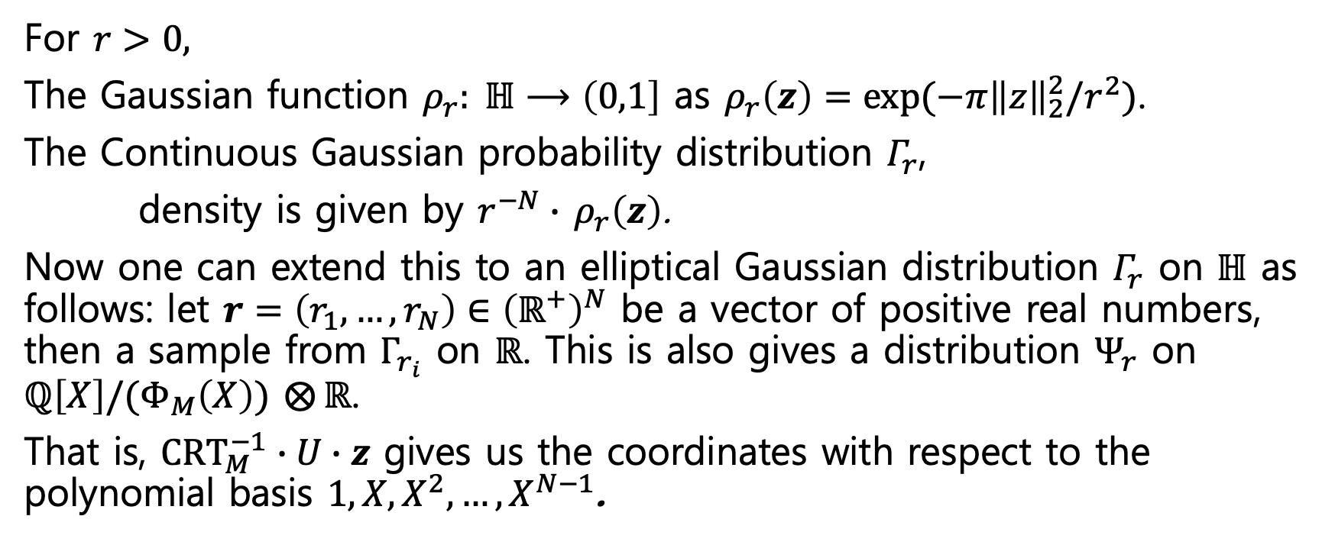
Gaussian Distributions and RLWE Problem
For $r>0,$
The Gaussian function $ρ_{r}: ℍ⟶\left(0,1\right]$ as $ρ_{r}\left(z\right)=exp⁡(−π{\left\|z\right\|}_{2}^{2}/r^{2})$.
The Continuous Gaussian probability distribution $Γ_{r}$,
density is given by $r^{−N}∙$ $ρ_{r}\left(z\right)$.
Now one can extend this to an elliptical Gaussian distribution $Γ_{r}$ on $ℍ$ as follows: let $r=\left(r_{1},…,r_{N}\right)∈{\left(ℝ^{+}\right)}^{N}$ be a vector of positive real numbers, then a sample from $Γ_{r_{i}}$ on $ℝ$. This is also gives a distribution $Ψ_{r}$ on $ℚ\left[X\right]/(Φ_{M}\left(X\right))$ $⨂{ℝ}$.
That is, $CRT_{M}^{−1}∙U∙z$ gives us the coordinates with respect to the polynomial basis $1, X, X^{2},…,X^{N−1}$.

Slide 8

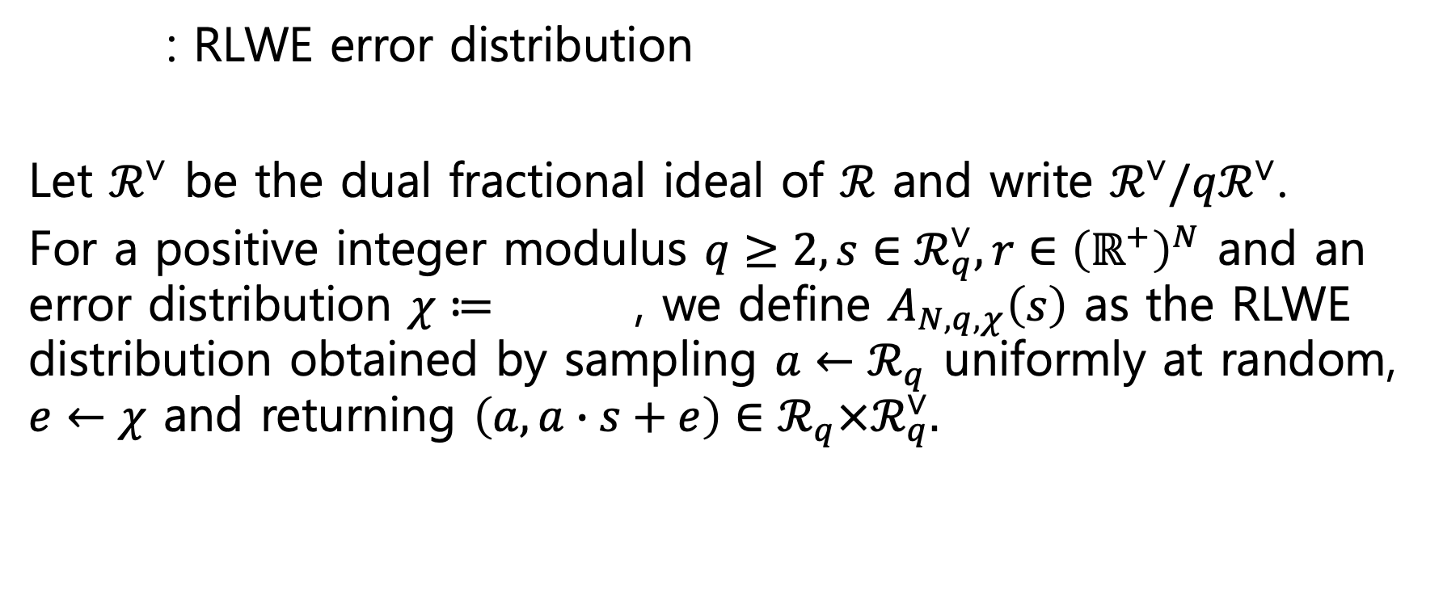
Gaussian Distributions and RLWE Problem
: RLWE error distribution
Let $ℛ^{∨}$ be the dual fractional ideal of $ℛ$ and write $ℛ^{∨}/qℛ^{∨}$.
For a positive integer modulus $q≥2, s∈ℛ_{q}^{∨}, r∈{\left(ℝ^{+}\right)}^{N}$ and an error distribution $χ≔$ , we define $A_{N,q,χ}\left(s\right)$ as the RLWE distribution obtained by sampling $a←ℛ_{q}$ uniformly at random, $e←χ$ and returning $\left(a,a∙s+e\right)∈ℛ_{q}×ℛ_{q}^{∨}.$

Slide 9
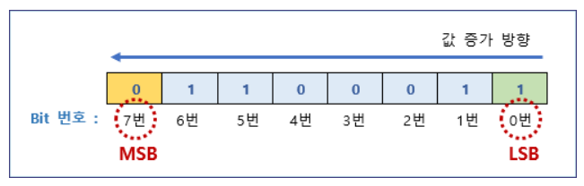
LSB and MSB

Slide 10
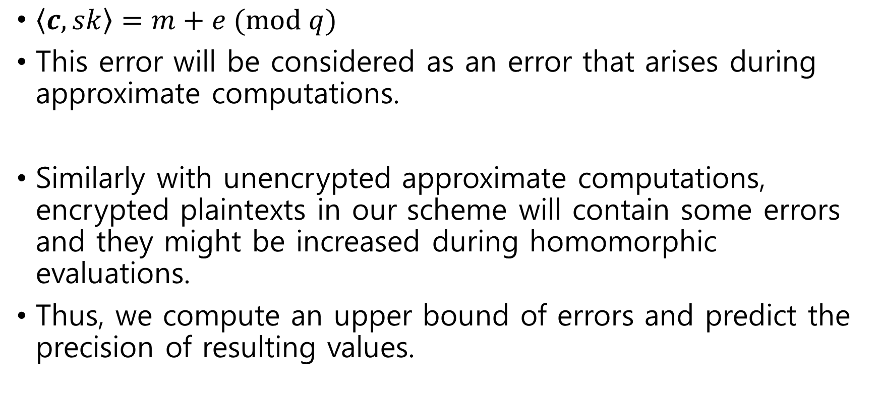
Decryption Structure
$\left\langle c, sk\right\rangle =m+e (mod q)$
This error will be considered as an error that arises during approximate computations.
Similarly with unencrypted approximate computations, encrypted plaintexts in our scheme will contain some errors and they might be increased during homomorphic evaluations.
Thus, we compute an upper bound of errors and predict the precision of resulting values.
Notes:
비 암호화 상태에서의 근사 연산에서도 연산을 연속적으로 할 때 오류가 발생할 수 있으므로, 계산된 결과가 원래의 값이 근접함을 고려해야함.
그래서 우리의 스킴도 오차 상한을 계산하고 정밀도를 예측한다.

Slide 11
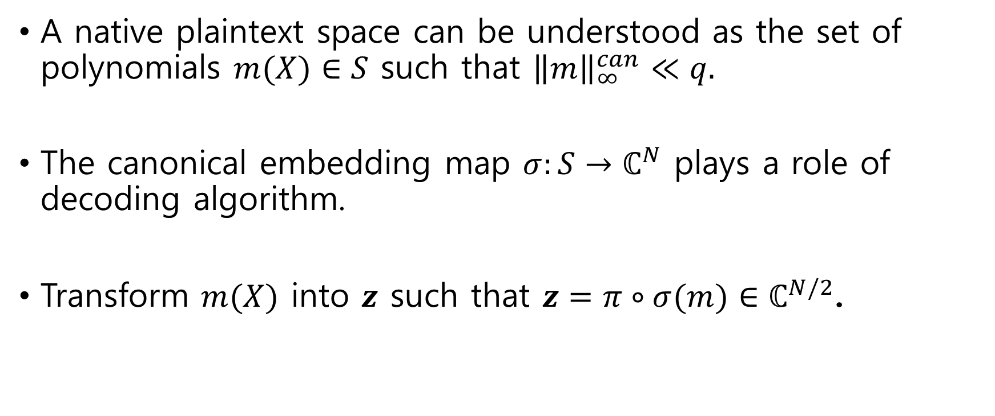
Plaintext Encoding for Packing
A native plaintext space can be understood as the set of polynomials $m(X)∈S$ such that ${\left\|m\right\|}_{∞}^{can}≪q.$
The canonical embedding map $σ:S→ℂ^{N}$ plays a role of decoding algorithm.
Transform $m(X)$ into $z$ such that $z=π∘σ(m)∈ℂ^{N/2}$.

Slide 12
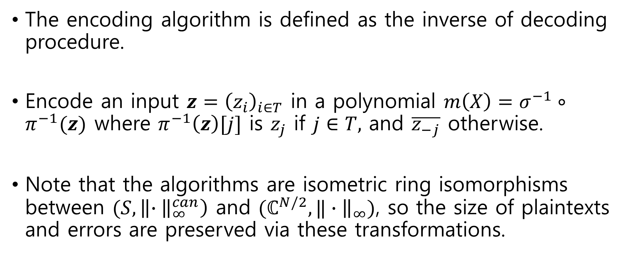
Plaintext Encoding for Packing
The encoding algorithm is defined as the inverse of decoding procedure.
Encode an input $z={\left(z_{i}\right)}_{i∈T}$ in a polynomial $m\left(X\right)=σ^{−1}∘π^{−1}(z)$ where $π^{−1}\left(z\right)[j]$ is $z_{j}$ if $j∈T,$ and $\overline{z_{−j}}$ otherwise.
Note that the algorithms are isometric ring isomorphisms between $(S,\left\|∙{\left.​\right\|}_{∞}^{can}\right)$ and $(ℂ^{N/2},‖∙{\left.​\right\|}_{∞})$, so the size of plaintexts and errors are preserved via these transformations.

Slide 13
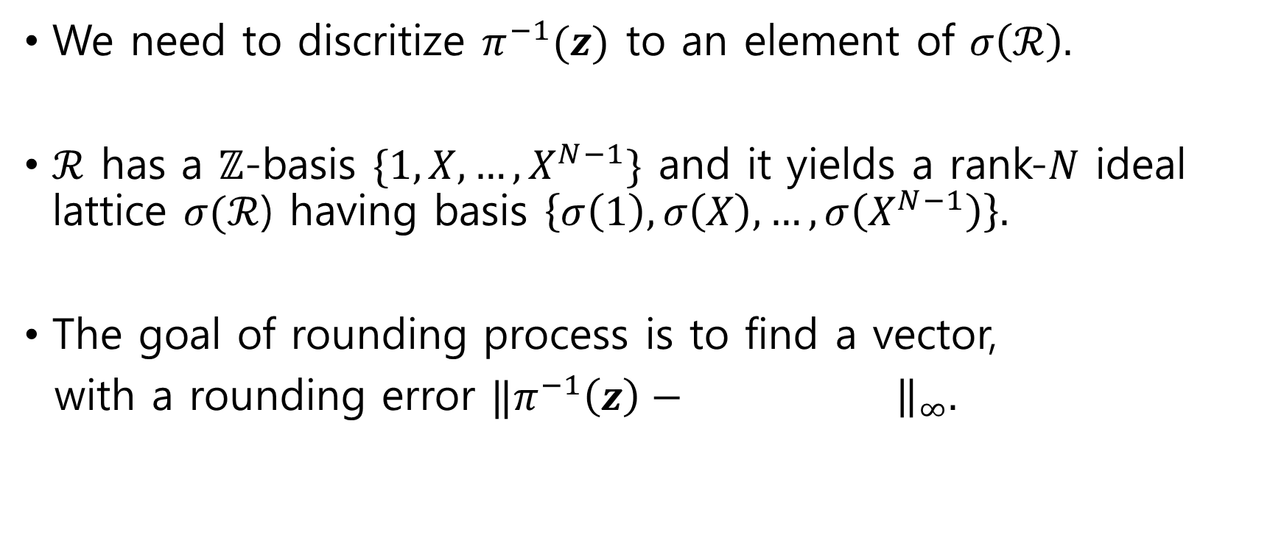
Plaintext Encoding for Packing
We need to discritize $π^{−1}(z)$ to an element of $σ\left(ℛ\right).$
$ℛ$ has a $ℤ$-basis $\{1,X,…,X^{N−1}\}$ and it yields a rank-$N$ ideal lattice $σ(ℛ$) having basis $\left\{σ\left(1\right),σ\left(X\right),…,σ\left(X^{N−1}\right)\right\}.$
The goal of rounding process is to find a vector,
with a rounding error $‖π^{−1}\left(z\right)−$ ${\left.​\right\|}_{∞}.$

Slide 14
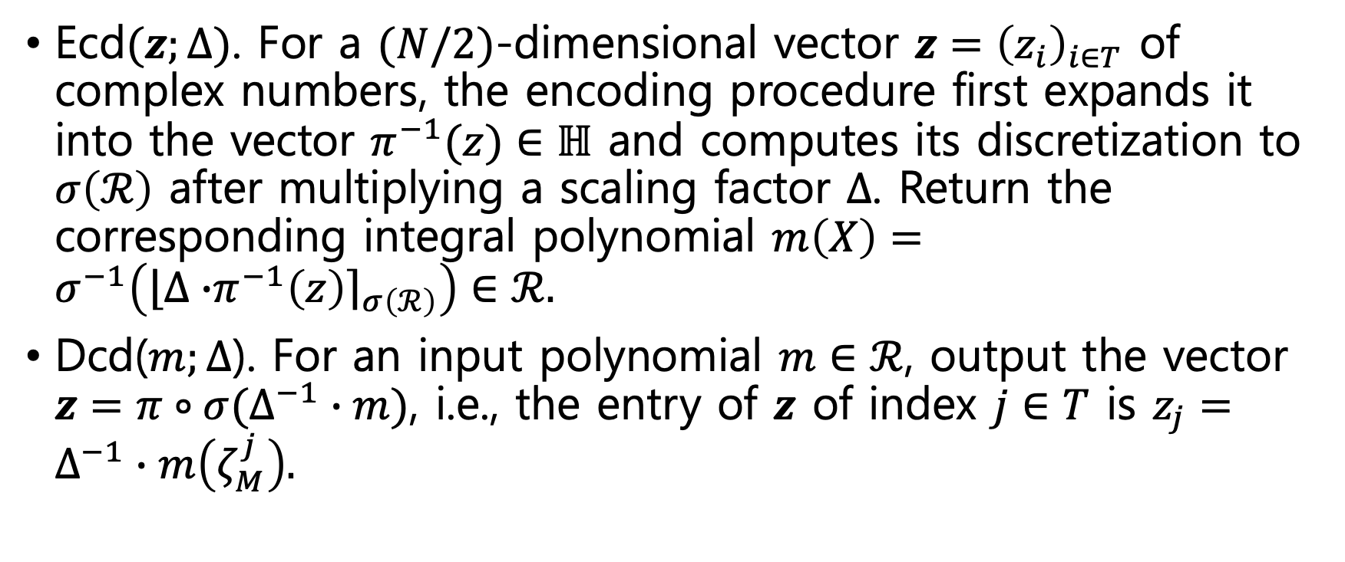
Plaintext Encoding for Packing
Ecd$(z;∆)$. For a $(N/2)$-dimensional vector $z={\left(z_{i}\right)}_{i∈T}$ of complex numbers, the encoding procedure first expands it into the vector $π^{−1}(z)∈ℍ$ and computes its discretization to $σ\left(ℛ\right)$ after multiplying a scaling factor $∆$. Return the corresponding integral polynomial $m\left(X\right)=σ^{−1}\left(\left\lfloor ∆∙\right.π^{−1}{\left.\left(z\right)\right\rceil }_{σ\left(ℛ\right)}\right)∈ℛ.$
Dcd($m;∆$). For an input polynomial $m∈ℛ$, output the vector $z=π∘σ(∆^{−1}∙m)$, i.e., the entry of $z$ of index $j∈T$ is $z_{j}=∆^{−1}∙m\left(ζ_{M}^{j}\right).$

Slide 15
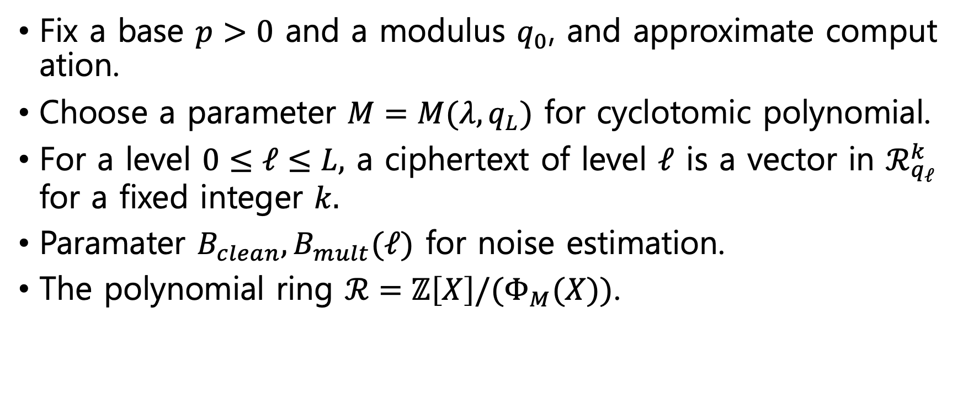
Leveled Homomorphic Encryption
Fix a base $p>0$ and a modulus $q_{0}$, and approximate computation.
Choose a parameter $M=M(λ,q_{L})$ for cyclotomic polynomial.
For a level $0≤ℓ≤L,$ a ciphertext of level $ℓ$ is a vector in $ℛ_{q_{ℓ}}^{k}$ for a fixed integer $k.$
Paramater $B_{clean}, B_{mult}(ℓ)$ for noise estimation.
The polynomial ring $ℛ=ℤ\left[X\right]/(Φ_{M}(X))$.

Slide 16
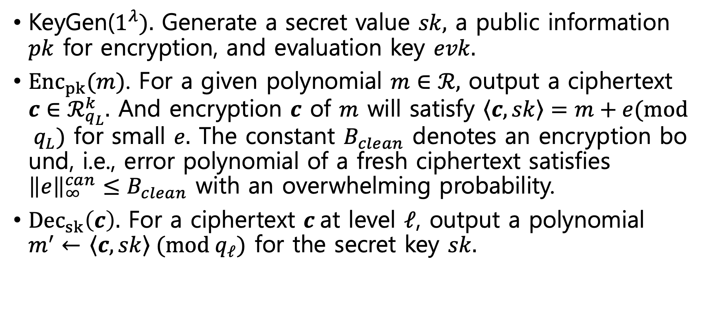
Leveled Homomorphic Encryption
KeyGen($1^{λ}).$ Generate a secret value $sk,$ a public information $pk$ for encryption, and evaluation key $evk.$
${Enc}_{pk}(m)$. For a given polynomial $m∈ℛ,$ output a ciphertext $c∈ℛ_{q_{L}}^{k}.$ And encryption $c$ of $m$ will satisfy $\left\langle c\right.,\left.sk\right\rangle =m+e(mod q_{L})$ for small $e.$ The constant $B_{clean}$ denotes an encryption bound, i.e., error polynomial of a fresh ciphertext satisfies ${\left\|e\right\|}_{∞}^{can}≤B_{clean}$ with an overwhelming probability.
${Dec}_{sk}\left(c\right).$ For a ciphertext $c$at level $ℓ$, output a polynomial $m^{′}←$ $\left\langle c\right.,\left.sk\right\rangle (mod q_{ℓ})$ for the secret key $sk.$

Slide 17
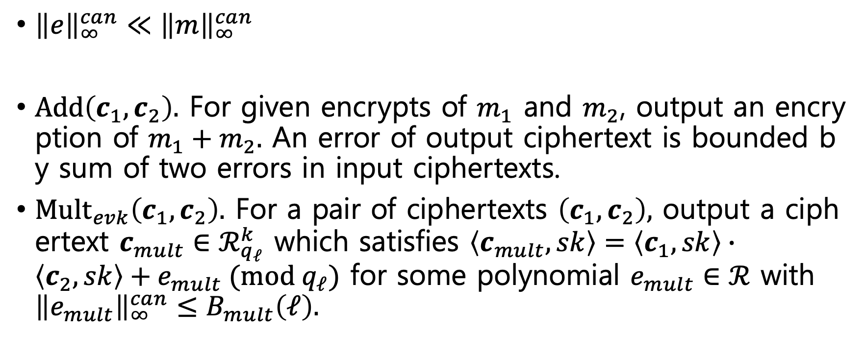
Leveled Homomorphic Encryption
${\left\|e\right\|}_{∞}^{can}≪{\left\|m\right\|}_{∞}^{can}$
$Add\left(c_{1},c_{2}\right).$ For given encrypts of $m_{1}$ and $m_{2}$, output an encryption of $m_{1}+m_{2}.$ An error of output ciphertext is bounded by sum of two errors in input ciphertexts.
$Mult_{evk}\left(c_{1},c_{2}\right).$ For a pair of ciphertexts $\left(c_{1},c_{2}\right),$ output a ciphertext $c_{mult}∈ℛ_{q_{ℓ}}^{k}$ which satisfies $\left\langle c_{mult},sk\right\rangle =\left\langle c_{1},sk\right\rangle ∙\left\langle c_{2},sk\right\rangle +e_{mult} (mod q_{ℓ})$ for some polynomial $e_{mult}∈ℛ$ with ${\left\|e_{mult}\right\|}_{∞}^{can}≤B_{mult}\left(ℓ\right).$
Notes:
기존의 스킴들과 다르게 이 스킴은 따로 평문 공간이 없다.
복호화 했을 때, 결과 값은 원래의 값과 조금 차이가 있다.

Slide 18
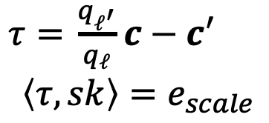
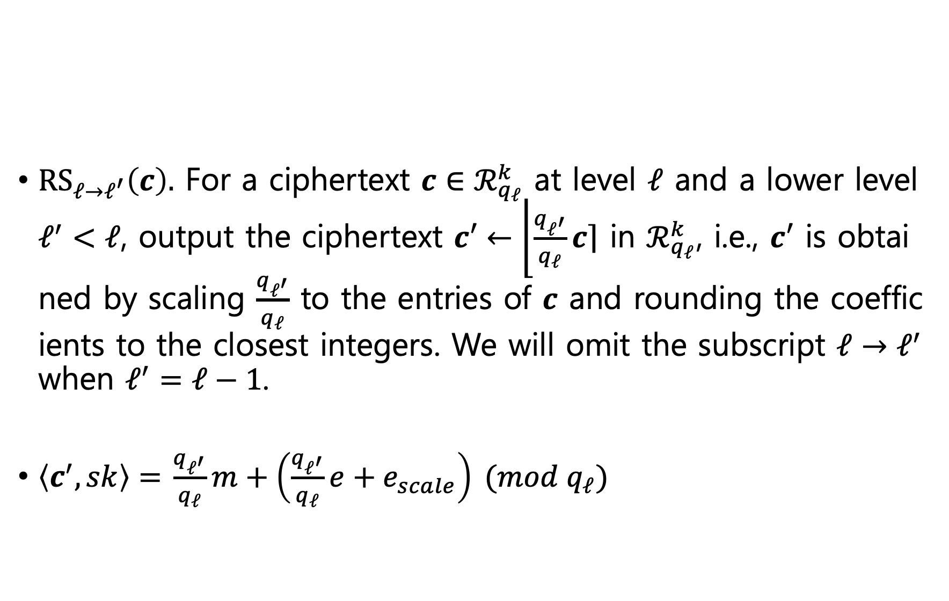
Resacling
$RS_{ℓ→ℓ^{′}}\left(c\right).$ For a ciphertext $c∈ℛ_{q_{ℓ}}^{k}$ at level $ℓ$ and a lower level $ℓ^{′}<ℓ$, output the ciphertext $c′←\left\lfloor \frac{q_{ℓ^{′}}}{q_{ℓ}}\right.\left.c\right\rceil$ in $ℛ_{q_{ℓ}}^{k}$, i.e., $c′$ is obtained by scaling $\frac{q_{ℓ^{′}}}{q_{ℓ}}$ to the entries of $c$ and rounding the coefficients to the closest integers. We will omit the subscript $ℓ→ℓ^{′}$ when $ℓ^{′}=ℓ−1$.
$\left\langle c^{′},sk\right\rangle =$ $\frac{q_{ℓ^{′}}}{q_{ℓ}}m+\left(\frac{q_{ℓ^{′}}}{q_{ℓ}}e+e_{scale}\right) (mod{ q}_{ℓ})$
$τ=$ $\frac{q_{ℓ^{′}}}{q_{ℓ}}c−c′$
$$\left\langle τ,sk\right\rangle =e_{scale}$$

Slide 19
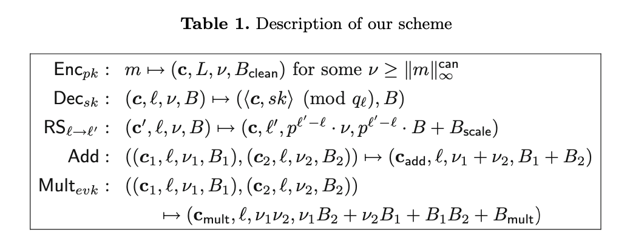
Tagged Informations

Slide 20
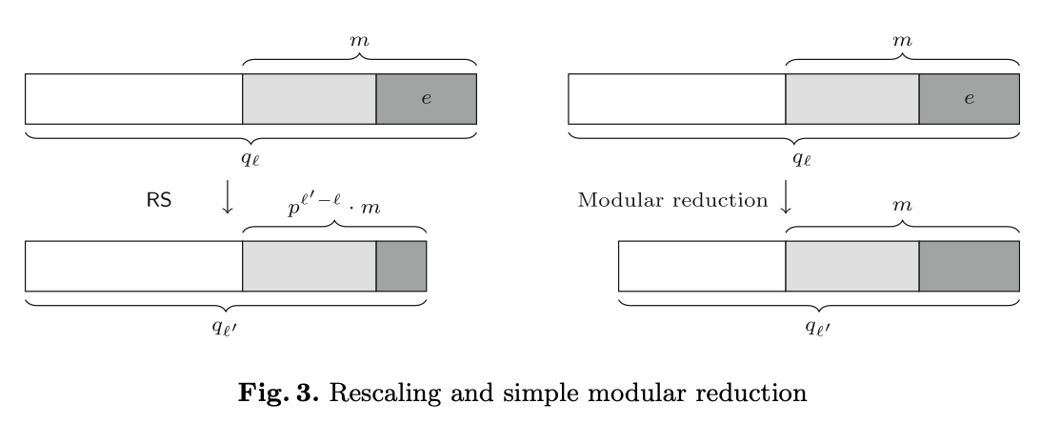

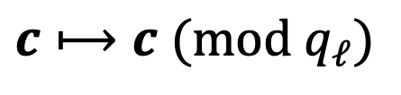
Operations at Different Levels.
$$RS_{ℓ→ℓ^{′}}\left(c\right)$$
$$c⟼c (mod q_{ℓ})$$
Notes:
연산하기전에 우리는 높은 레벨에 있는 암호문 벡터를 낮은 레벨로 가져와야한다.
두가지 방법이 있다.
Simple modular reduction 과 RS procedure

Slide 21
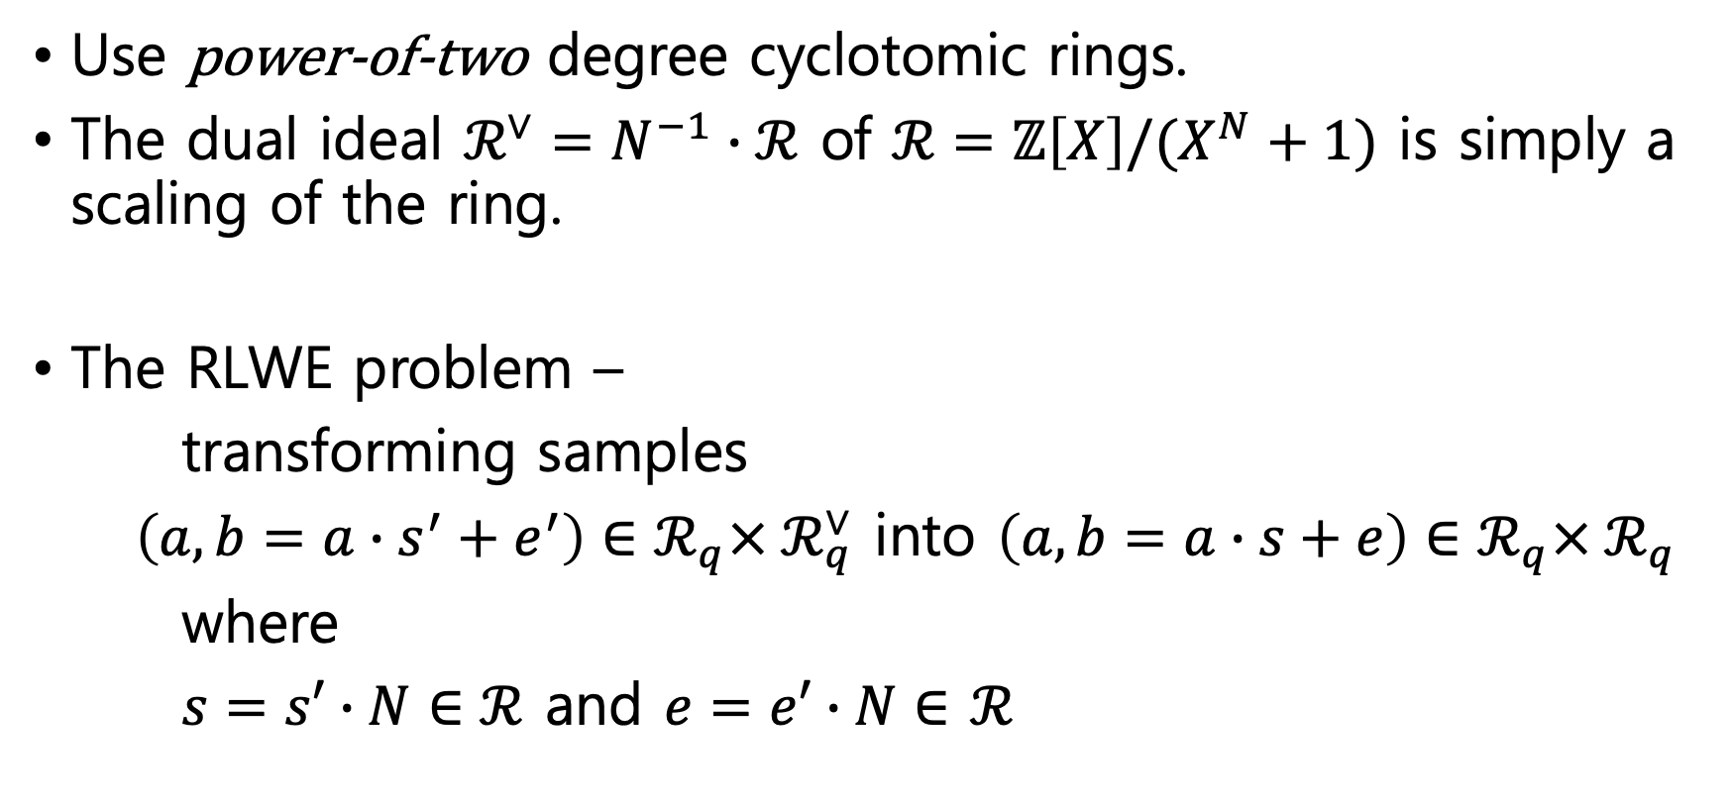
Concrete Construction of RLWE-based HE
Use power-of-two degree cyclotomic rings.
The dual ideal $ℛ^{∨}=N^{−1}∙ℛ$ of $ℛ=ℤ\left[X\right]/(X^{N}+1)$ is simply a scaling of the ring.
The RLWE problem –
transforming samples
$\left(a,b=a∙s^{′}+e^{′}\right)∈ℛ_{q}×{ ℛ}_{q}^{∨}$ into $\left(a,b=a∙s+e\right)∈ℛ_{q}×{ ℛ}_{q}$
where
$s=s′∙N∈ℛ$ and $e=e′∙N∈$ $ℛ$
Notes:
2의 제곱 사이클로토믹은 반올림 연산에 효율적.
에러는 이산 가우시안 분포에서 독립적으로 샘플링

Slide 22
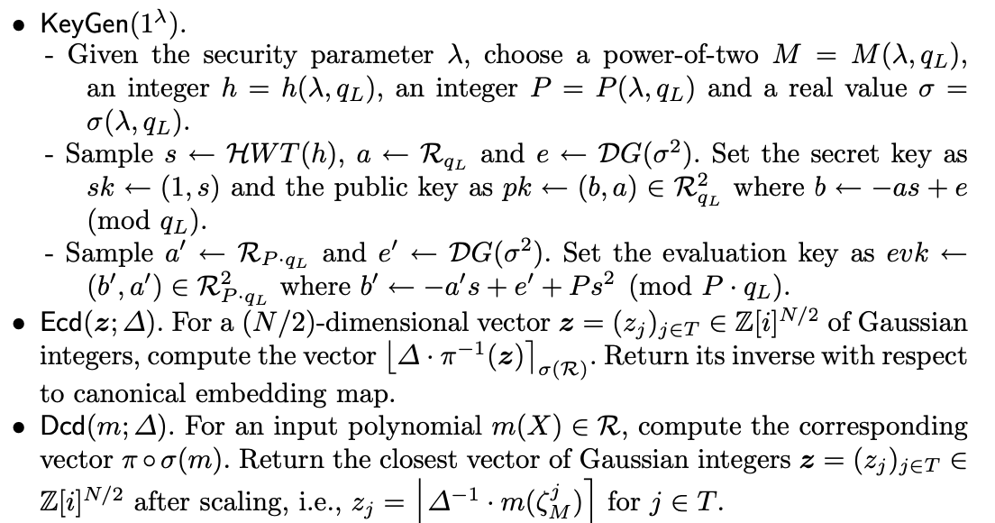
Concrete Construction of RLWE-based HE
Notes:
에러는 이산 가우시안 분포에서 독립적으로 샘플링

Slide 23
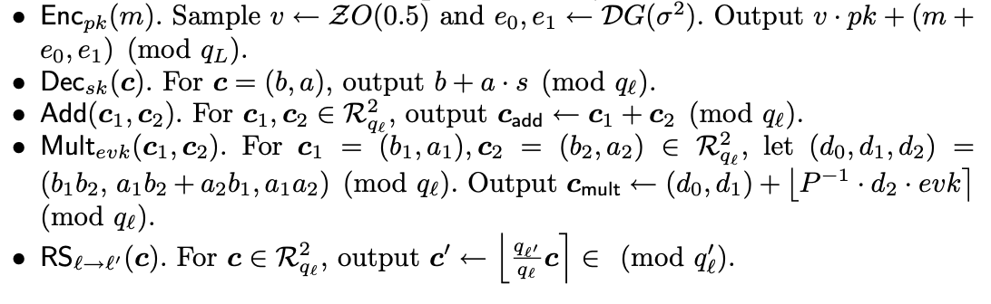
Concrete Construction of RLWE-based HE
Notes:
에러는 이산 가우시안 분포에서 독립적으로 샘플링

Slide 24
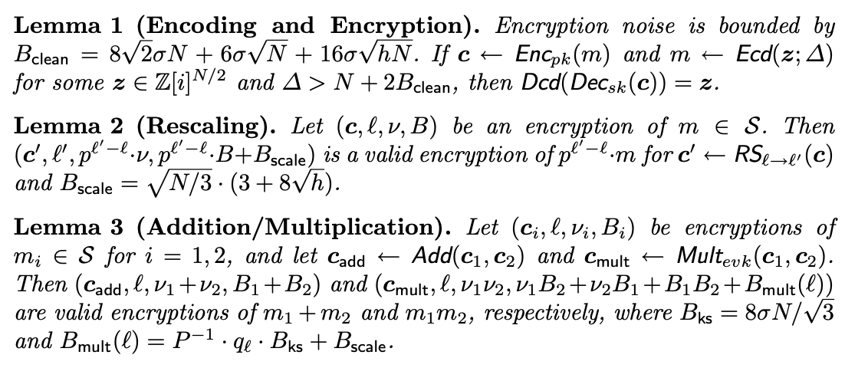
Lemma

Slide 25
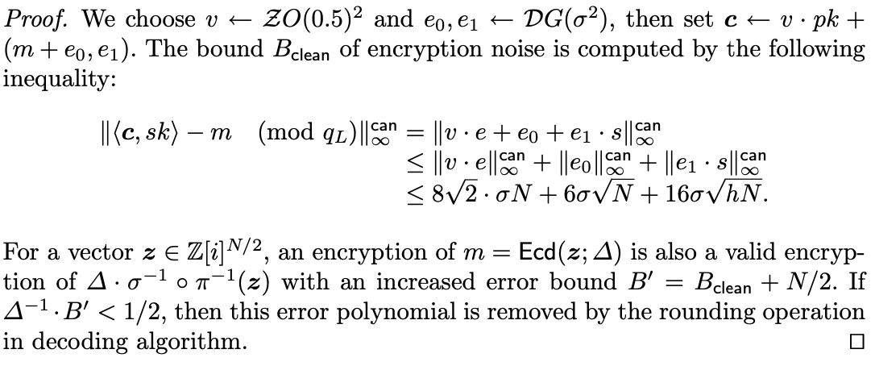
B - Proof of Lemma1
Notes:
Canonical Embedding norm 에서 연산 성질

Slide 26
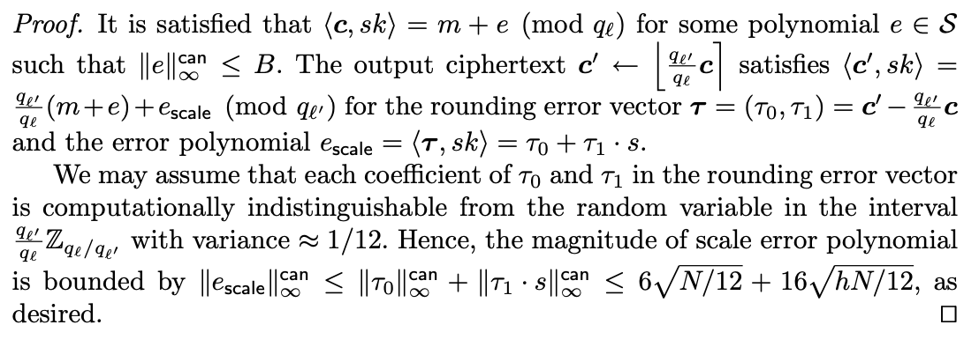
B - Proof of Lemma2

Slide 27
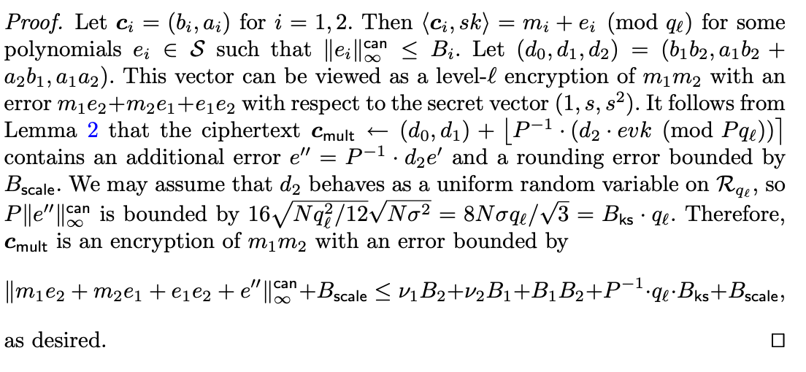
B - Proof of Lemma3

Slide 28

Permutations over the Plaintext Slots
$Gal=Gal(ℚ(ζ_{M})/ℚ$) consists of mappings $κ_{k}:m\left(X\right)⟼m\left(X^{k}\right) \left(mod Φ_{M}\left(X\right)\right)$ for a polynomial $m\left(X\right)∈ℛ$ and all $k$ co-prime with $M$, and that it is isomorphic to $ℤ_{M}^{∗}$.

Slide 29

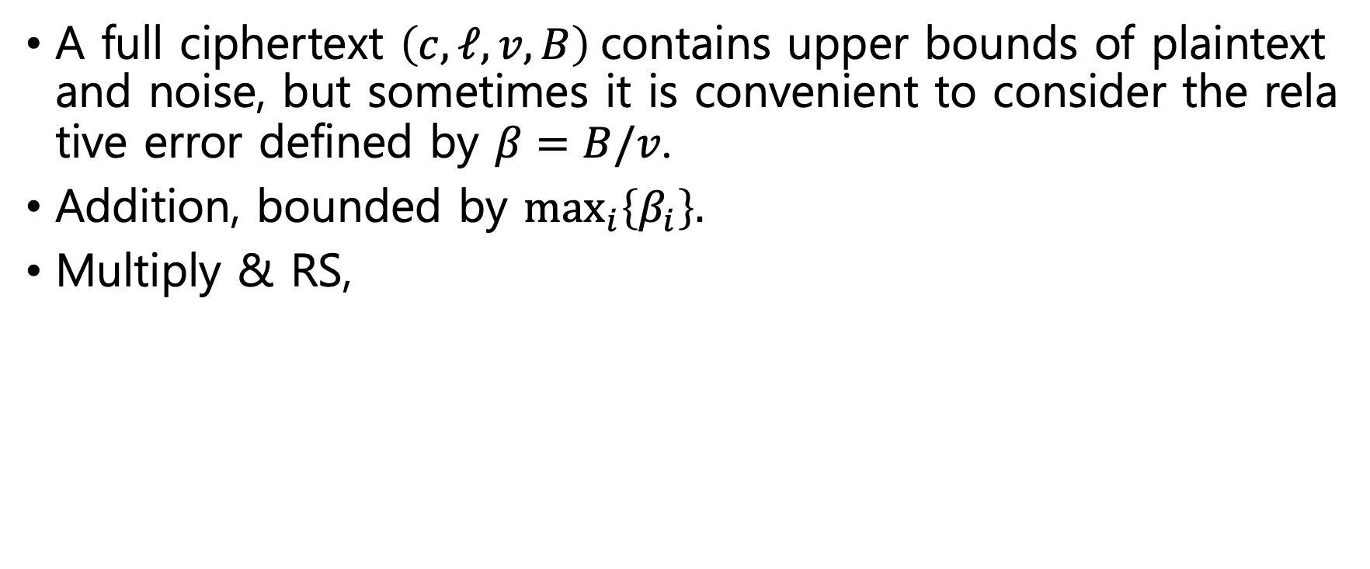

Relative Error
A full ciphertext $\left(c,ℓ,v,B\right)$contains upper bounds of plaintext and noise, but sometimes it is convenient to consider the relative error defined by $β=B/v$.
Addition, bounded by $\max_{i}\left\{β_{i}\right\}.$
Multiply & RS,
$$β_{∗}$$
* from lemma 2 and 3.
Notes:
동형 연산을 하면서 노이즈가 커지고 이것은 정확도에 영향을 미치게된다.

Slide 30
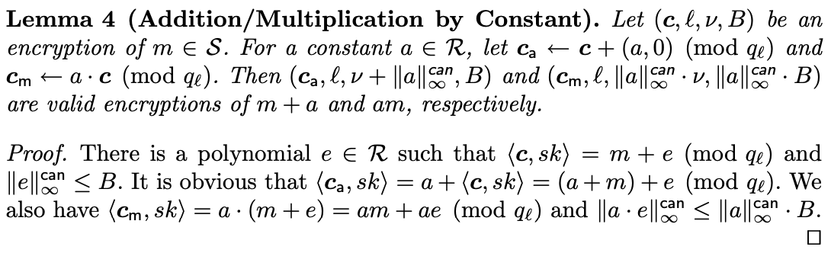
Polynomial Functions

